Slide 1
PARABOLIC CATENARY
BY
Dr. L. BENEDICT MICHAEL RAJ HEAD & ASSOCIATE PROFESSOR
PG & RESEARCH DEPT. OF MATHEMATICS
  ST. JOSEPH’S COLLEGE(AUTONOMOUS),
  TIRUCHIRAPPALLI – 620 002

Slide 2
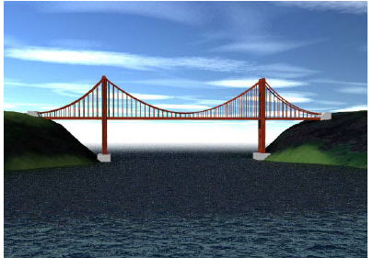
PARABOLIC CATENARY

Slide 3
Dear Students, In today’s life, we see many real life examples of a Parabola.
Some of them are
Suspension Bridges.
Flight of a Base ball.
Satellite dishes.
Smiles
A spider’s web (multiple catenaries)and many more…

Slide 4
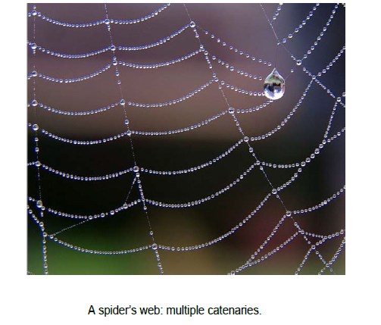

Slide 5
Before we proceed to parabolic Catenary, let us see the difference between Catenary and Parabolic Catenary.

Slide 6

The Catenary and the parabola are two different curves but they look similar.
1. Parabola, in its simplest form, is, y = x²
2. Catenary , on the other hand is
y = cosh(x)=

Slide 7
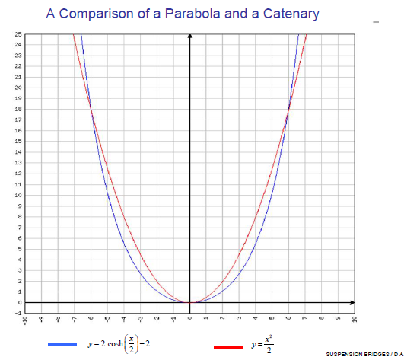
Figure 1

Slide 8
In the common catenary, the load per unit length of chain is constant. When a wire is stretched tightly between two points, its weight may be considered to be uniformly distributed across the span.
We shall now prove the following proposition.

Slide 9
A string hangs under gravity and is so loaded that the weight on each element of it is proportional to the horizontal projection of that element; show that it will hang in the form of a parabola.

Slide 10
Let the string be hung from the point C and D, let A be its lowest point and take the horizontal and vertical through O as axes of x and y respectively,

Slide 11
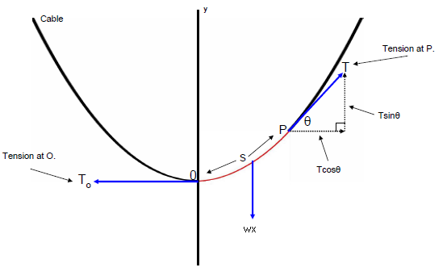
C
D
Parabolic catenary
Figure 2
Notes:
Figure 2 : Parabolic Catenary

Slide 12
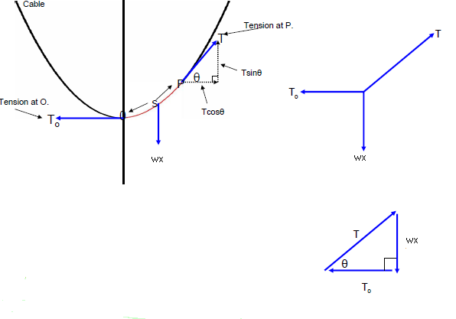
1. The three forces T₀ ,T and wx are in equilibrium.
Figure 2

Slide 13
The three forces T₀ ,T and wx are in equilibrium.
They form a triangle of forces with tan θ = wx/T₀
Figure 3

Slide 14
The three forces T₀ ,T and wx are in equilibrium.
They form a triangle of forces with tan θ = wx/T₀
since T is tangential to the curve formed by the chain tan θ is equal to the gradient at the point P.
Figure 4

Slide 15
The three forces T₀ ,T and wx are in equilibrium.
They form a triangle of forces with tan θ = wx/T₀
since T is tangential to the curve formed by the chain tan θ is equal to the gradient at the point P.
Gradient = wx/T₀
Figure 5

Slide 16
Consider the equilibrium of a finite portion OP of the string and let p be (x,y) . Let w be the weight per unit length of the string measured horizontally.

Slide 17
The forces acting on the portion OP are
1) tension T₀ at O which is horizontal
2) tension T at P acting along the tangent at P, inclined at an angle θ to OX
3) weight of the portion OP,
Hence these three forces are in equilibrium

Slide 18


Resolving horizontally and vertically ,
we have,
T cosθ = T₀ ------------- (1)
T sinθ = wx ------------ (2)
dividing (2) by (1),
tan θ = ----------- (3)
i.e., = ------------ (4)

Slide 19

integrating, y = + c ---------- (5)
but y = 0 when x = 0,
∴ c = 0
y = -----------(6)
Equation (6) is a parabola with vertex at the origin and its axis being along the y-axis.

Slide 20


If we put T₀ = wc ------------- (7)
i.e., T₀ is equal to the load on a length ‘c’ of the horizontal span.
Then (6) becomes y = =
x² = 2cy ------------ (8)
(8) is a parabola with lactus rectum 2c.

Slide 21

squaring (1) & (2) and adding
T² = T₀² + w²x²
= w²c²+w²x²
` = w²(c²+x²)
= w²(c²+2cy)
∴ T = w --------- (9)
this gives the tension at any point

Slide 22
Now , we discuss about one of the real life parabola (i.e.,) Suspension Bridges.

Slide 23
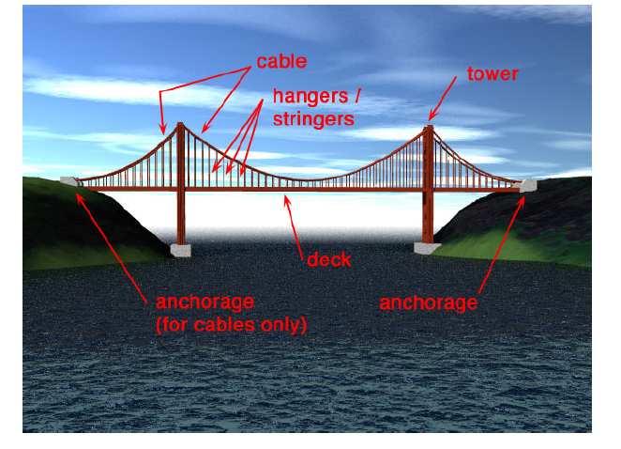

Slide 24
In the case of a suspension bridge the main load is the weight of the roadway. We have two chains hung up so as to be parallel, their ends being firmly fixed to supports. From different points of these chains, hang supporting chains or rods which carry the roadway of the bridge. These supporting rods are spaced at equal horizontal distances from one another and so carry equal loads.

Slide 25
The weight of the chain itself and the weights of the supporting rods may be neglected in comparison with that of the horizontal roadway. The weight supported by each of the rods may therefore be taken to be the weight of equal portions of the roadway . Thus , we have the case of parabolic catenary.

Slide 26
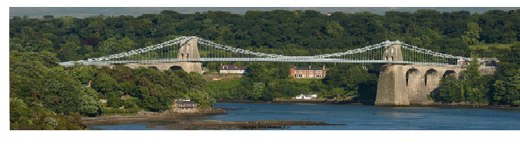
The Menai Suspension Bridge
Thomas Telford, Completed 1826

Slide 27
Hence the figure of each chain of a suspension bridge approximates very closely to that of a parabola. We will have therefore two parallel parabolas.

